Slide 1
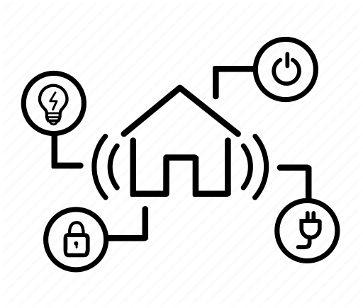

Presentation for the management team
Andrej Ondracka
IoT Analytics
8.11.2019

Slide 2
Our role in creating smarter homes
We at IoT analytics are developing a user-friendly energy consumption monitoring and forecasting for smart homes.

Slide 3


The benefits for the final consumer
- Convenience of monitoring and managing your electricity consumption on a user-friendly dashboard
- Opportunity to increase energy efficiency
- Improved safety and security

Slide 4
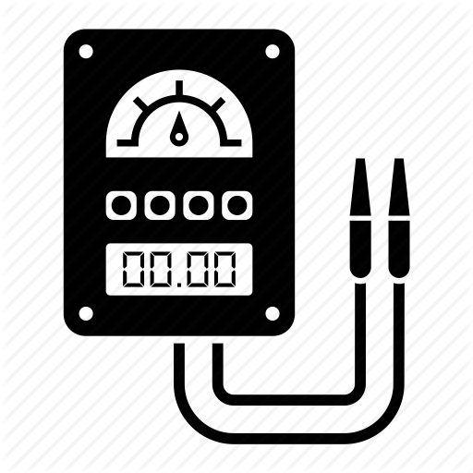
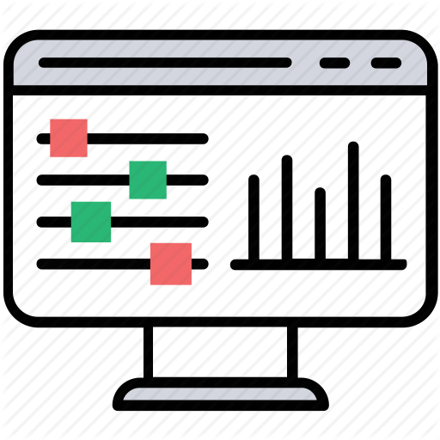
The product
Installing the energy sub-meters at home
A dashboard application to monitor and control energy consumption in real-time

Slide 5
Examples of insights the device can give
CASE STUDY: An example smart home, with 3 sub-meters installed:
- Sub meter 1: kitchen (dishwasher, oven, microwave)
- Sub meter 2: laundry room (washer, dryer, refrigerator, light)
- Sub meter 3: water-heater and air-con
- Other (not metered): including living room, computers, TV..

Slide 6
Total amount of energy spent by the home
Daily consumption (kWh)

Slide 7
Consumption by meter
Kitchen
Daily consumption (kWh)
Daily consumption (kWh)
Laundry Room
Hot water/AC
Daily consumption (kWh)
Other
Daily consumption (kWh)

Slide 8
Baseline energy consumption on holidays
Energy consumption on August 19th, 2008
Baseline energy consumption of 4.5 kWh per day!

Slide 9
Consumption of the refrigerator
How much does the refrigerator consume?

Slide 10
Consumption of the refrigerator
- extracting days when only refrigerator was in use (removing days with other consumption spikes).
- linear fit of refrigerator consumption over time.

Slide 11
Consumption of the refrigerator
Daily consumption of the refrigerator in its baseline usage increases by ~45 Wh every year.

Slide 12
Forecasting of the total monthly energy consumption
Can we predict how much the household will consume next year?
- Using monthly energy consumption data from 2007-2009, can we accurately predict trends and seasonality of energy consumption in 2010?

Slide 13
Forecasting of the total monthly energy consumption

Slide 14
Forecasting of the total monthly energy consumption

Slide 15
Forecasting the total monthly energy consumption

Slide 16
Recommendations
- The house loses 4.5 kWh of energy every day – find ways how to reduce this phantom load.
- Installing more submeters would greatly improve the accuracy of predictions.
- Refrigerators become less efficient over time – consider replacing the old refrigerator.
- Global household consumption trends – forecasting future energy consumption trend can help with energy planning.

Slide 17
The dashboard – beta version

Slide 18
Thank you!

Slide 19
Thank you!

